Slide 1
Revenge of the Worms: Rethinking Non-linear Mixed Effect Models
Gina
October 14 2020

Slide 2
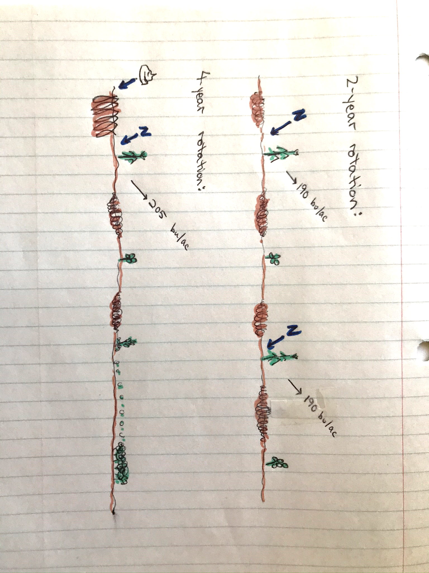

Slide 3
Rethinking!
Corn Yields
Cropping system history
?

Slide 4
Rethinking!
Corn Yields
Cropping system history
?
Tillage
Disease
Nutrient distribution
Root channels
A kazillion other things

Slide 5
Rethinking!
Corn Yields
Cropping system history
?
Tillage
Disease
Corn Roots
Nutrient distribution
Root channels
A kazillion other things

Slide 6
Rethinking!
Corn Yields
Cropping system history
?
Tillage
Disease
Corn Roots
Nutrient distribution
Root channels
A kazillion other things

Slide 7
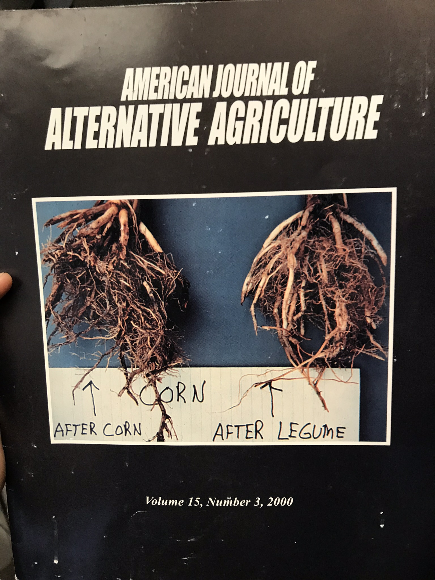
Cropping system history
?
Corn Roots
Tillage
Disease
Nutrient distribution
Root channels
A kazillion other things

Slide 8
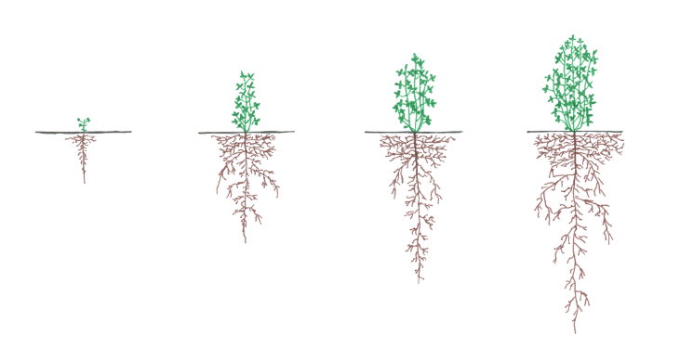
Maximum Root Depth
0
10
20
30
40
50
Days After Planting

Slide 9
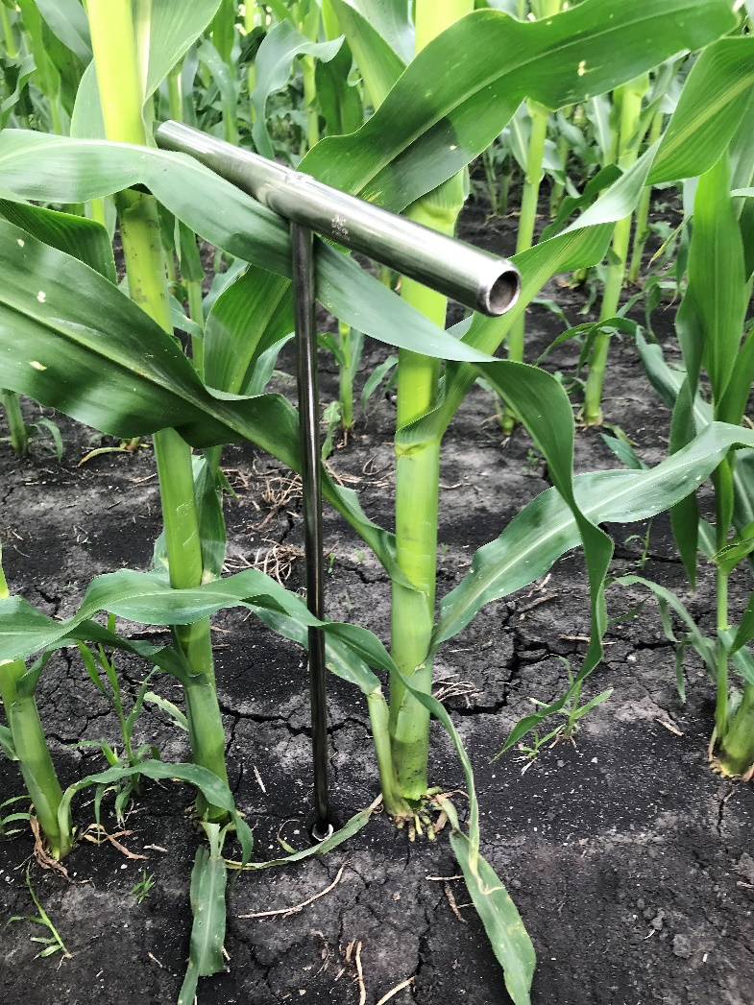
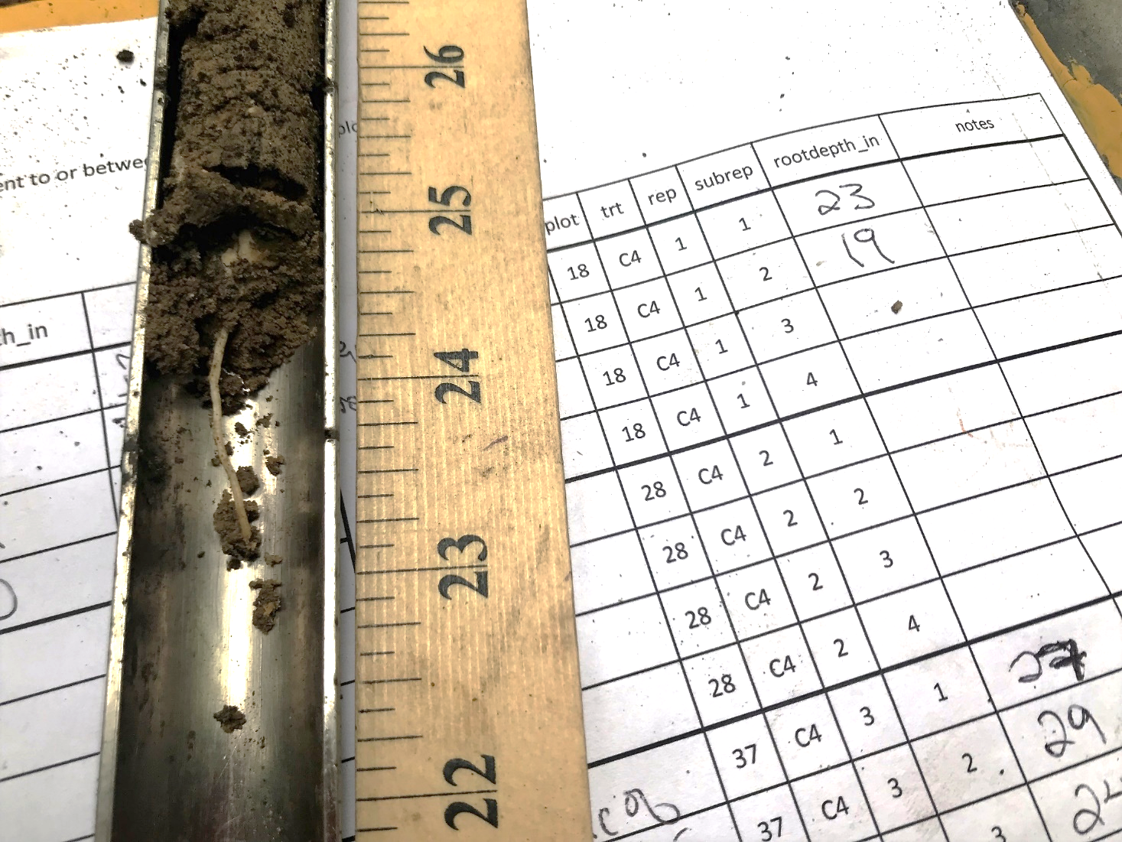
Maximum Root Depth
0
10
20
30
40
50
Days After Planting

Slide 10
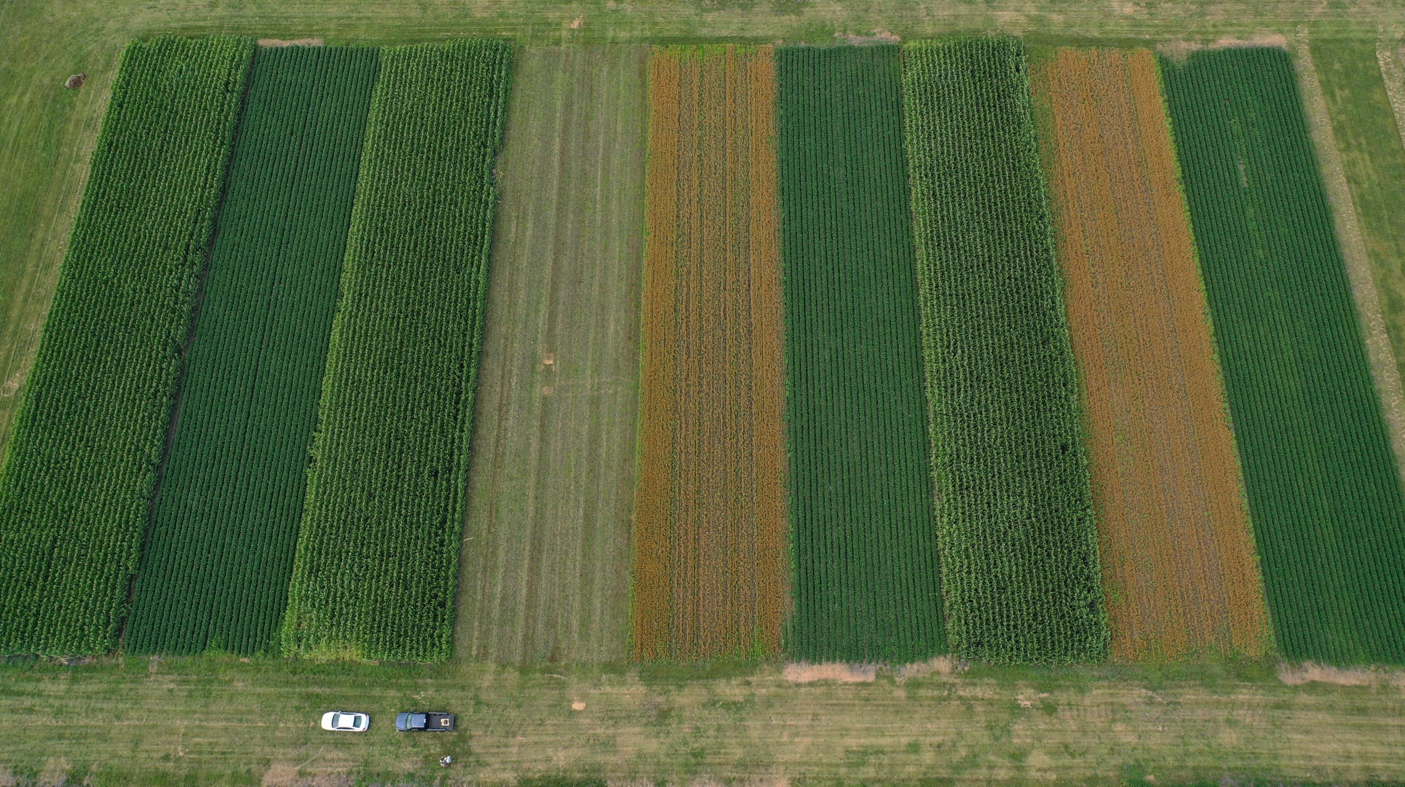
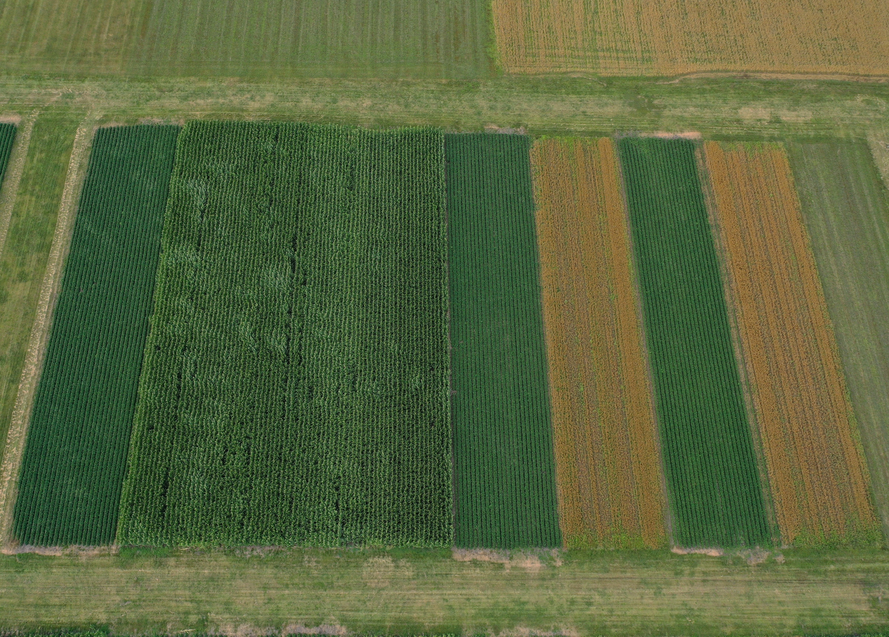
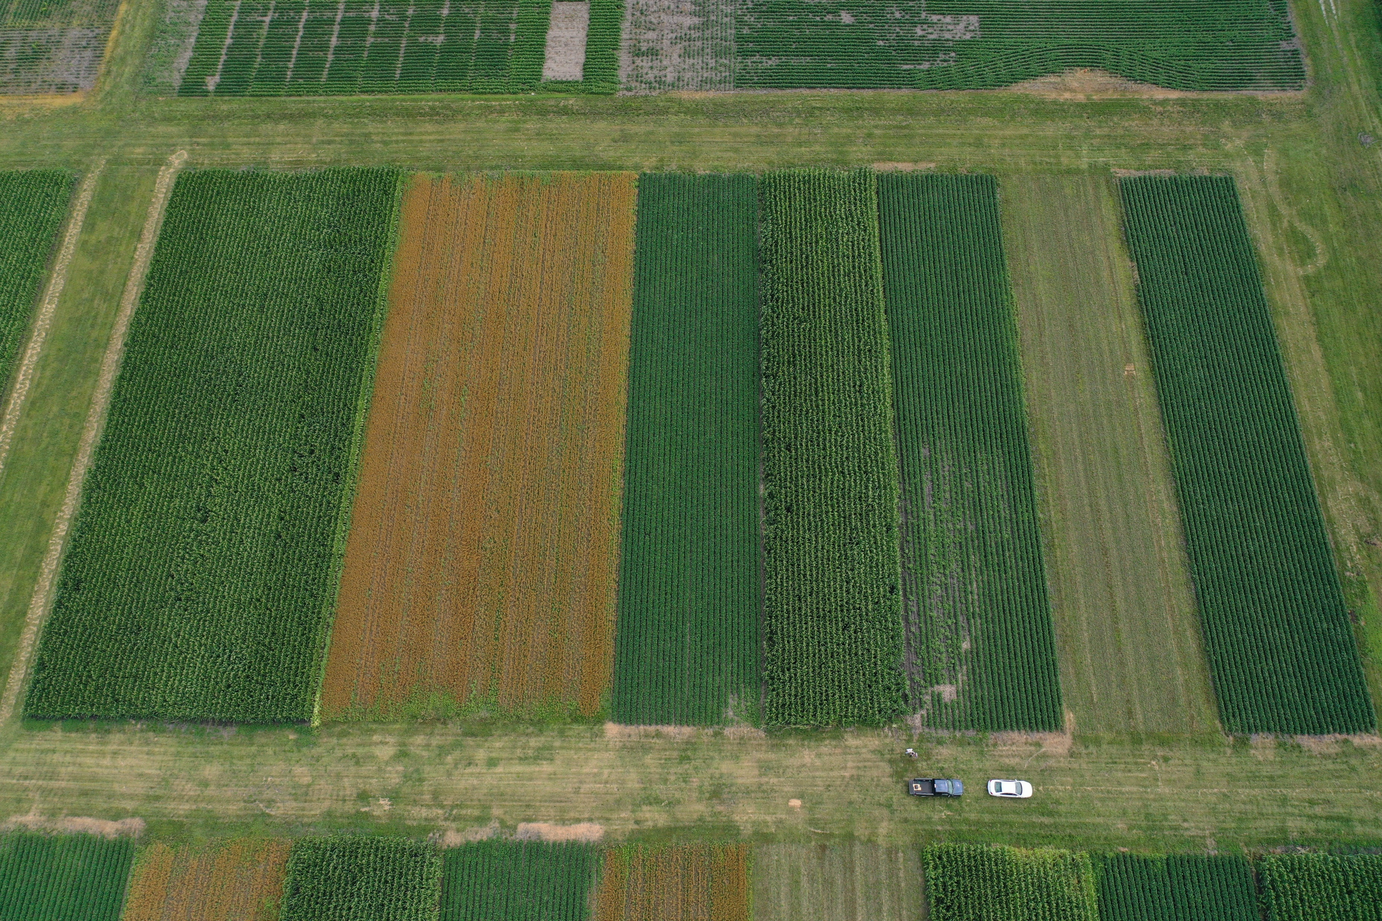
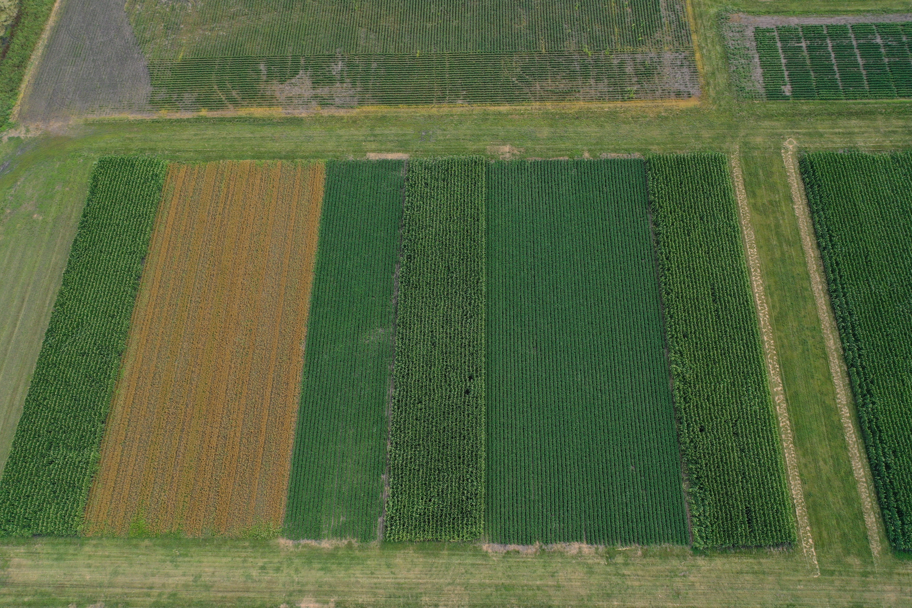

Slide 11
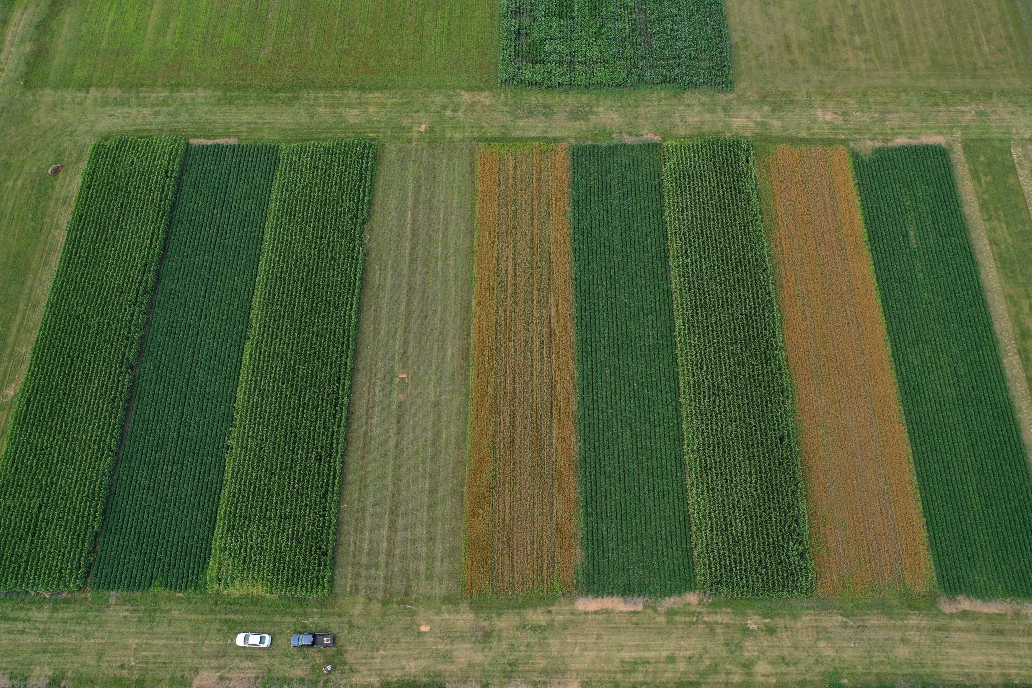

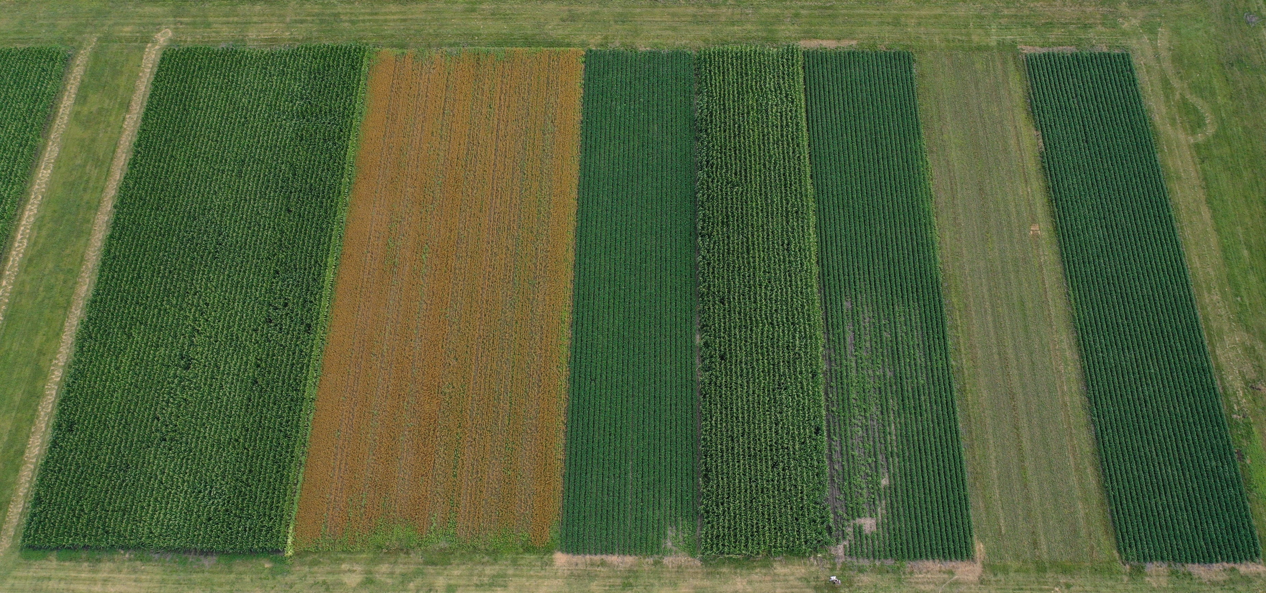
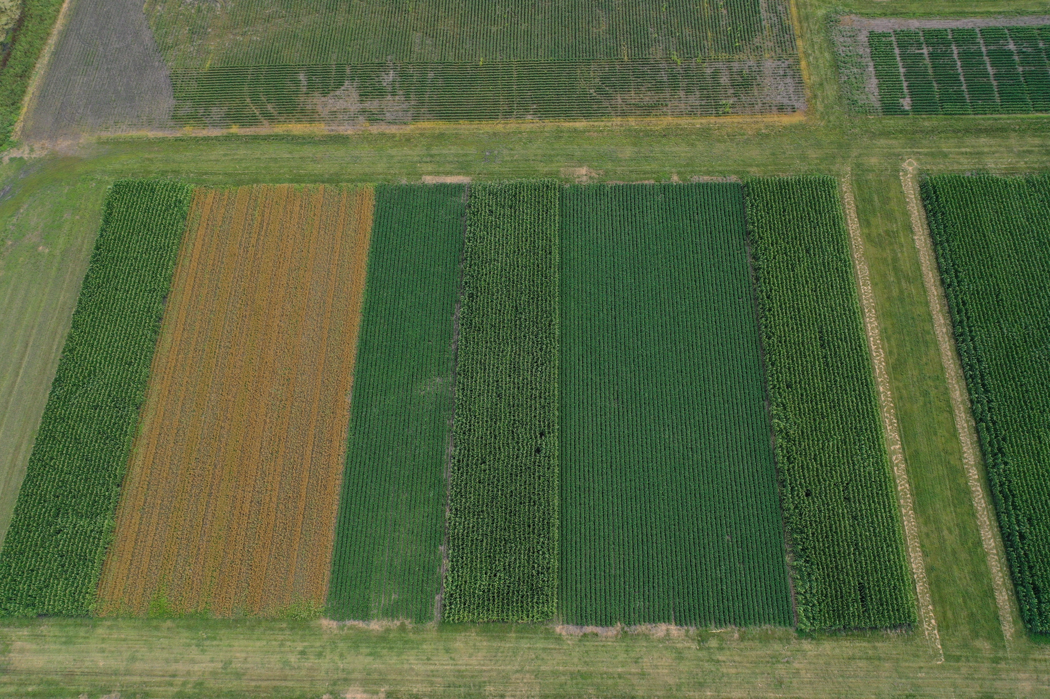
June 1
June 15
May 1
…

Slide 12
June 1
June 15
May 1
…
June 1
June 15
May 1
…
June 1
June 15
May 1
…

Slide 14
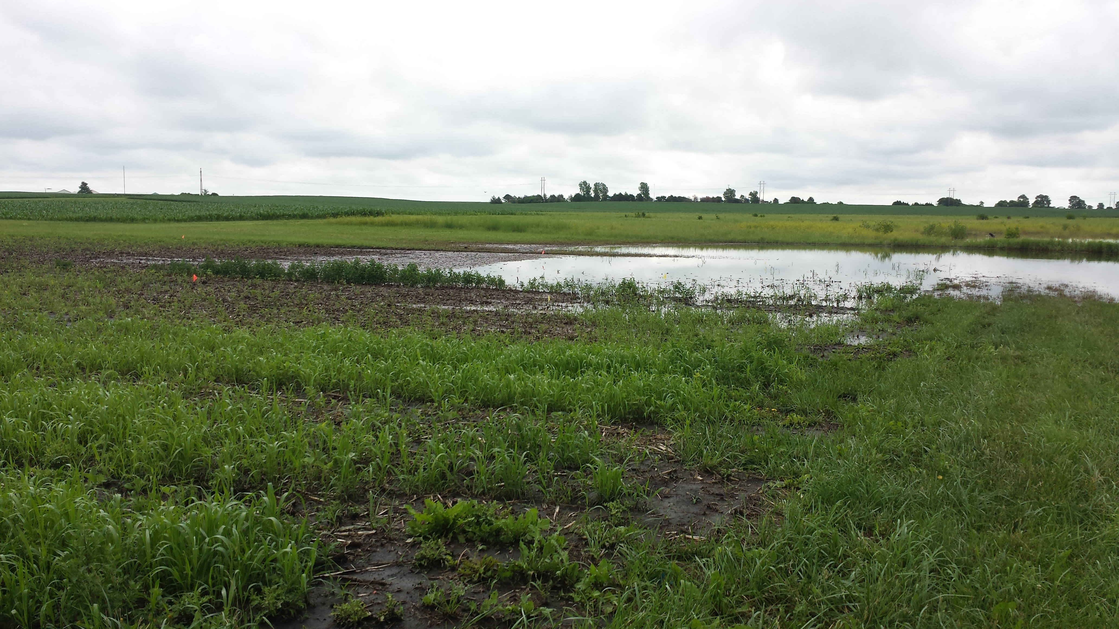
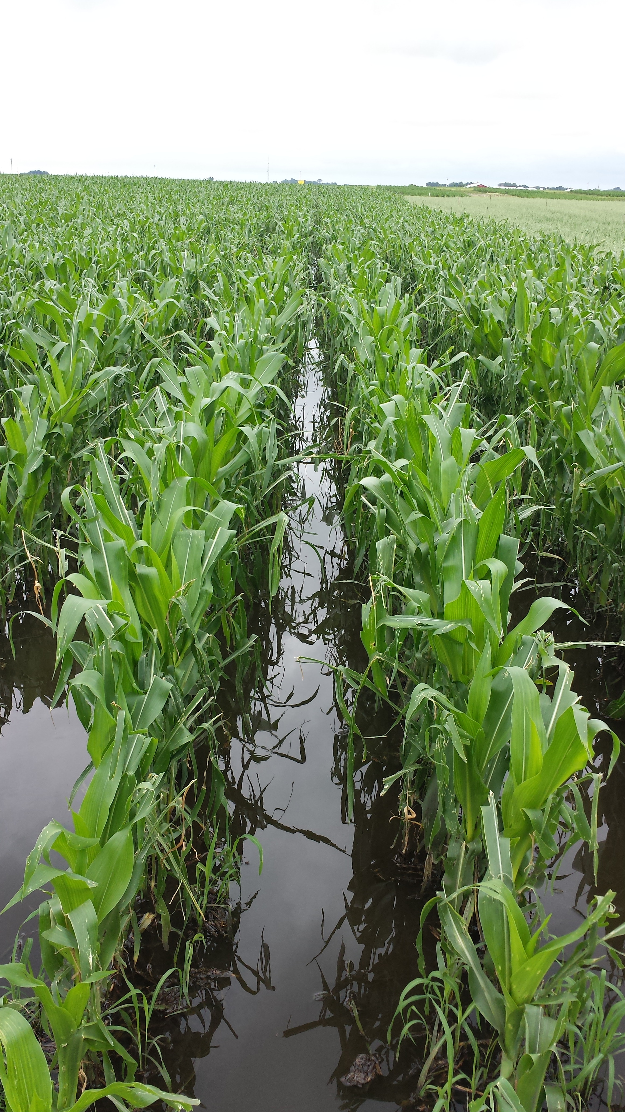

Slide 15
Simple Rotation
Diverse Rotation
2018
2019
2020

Slide 16
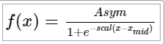
Simple Rotation
Diverse Rotation
2018
2019
2020

Slide 17
Simple Rotation
Diverse Rotation
2018
2019
2020

Slide 18
Simple Rotation
Diverse Rotation
2018
2019
2020
Asym_{i} ~ Normal (μ_{i,} σ)
μ_{i} = μ_{overall} + β_{rot} + α_{year} + γ_{plot}
β_{j} ~ Normal (0, 10) for j = 1 (“fixed” effect of diverse rotation treatment)
α_{j} ~ Normal (α, σ_{α}) for j = 1, 2, 3 (year effect comes from a distribution with a mean of α)
α ~ Normal (0, 1.5) (the mean of the year effect distribution is normally distributed)
σ_{α} ~Exponential(1) (the sd of the year effect distribution has a distribution)
γ_{j} ~ Normal (γ, σ_{γ}) for j = 1..24 (plot effect comes from a distribution with a mean of γ)
γ ~ Normal(0, 1.5)
σ_{γ}~Exponential(1)
σ ~ Exponential(1)

Slide 19
Simple Rotation
Diverse Rotation
2018
2019
2020
Maxrootdepth_{i} ~ Normal (μ_{i,} σ)
μ_{i} = μ_{overall} + β_{rot} + α_{year} + γ_{plot}
β_{j} ~ Normal (0, 10) for j = 1 (“fixed” effect of diverse rotation treatment)
α_{j} ~ Normal (α, σ_{α}) for j = 1, 2, 3 (year effect comes from a distribution with a mean of α)
α ~ Normal (0, 1.5) (the mean of the year effect distribution is normally distributed)
σ_{α} ~Exponential(1)
γ_{j} ~ Normal (γ, σ_{γ}) for j = 1..24 (plot effect comes from a distribution with a mean of γ)
γ ~ Normal(0, 1.5)
σ_{γ}~Exponential(1)
σ ~ Exponential(1)

Slide 20
Simple Rotation
Diverse Rotation
2018
2019
2020

Slide 21
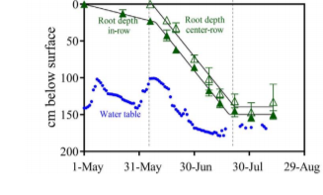

Slide 22

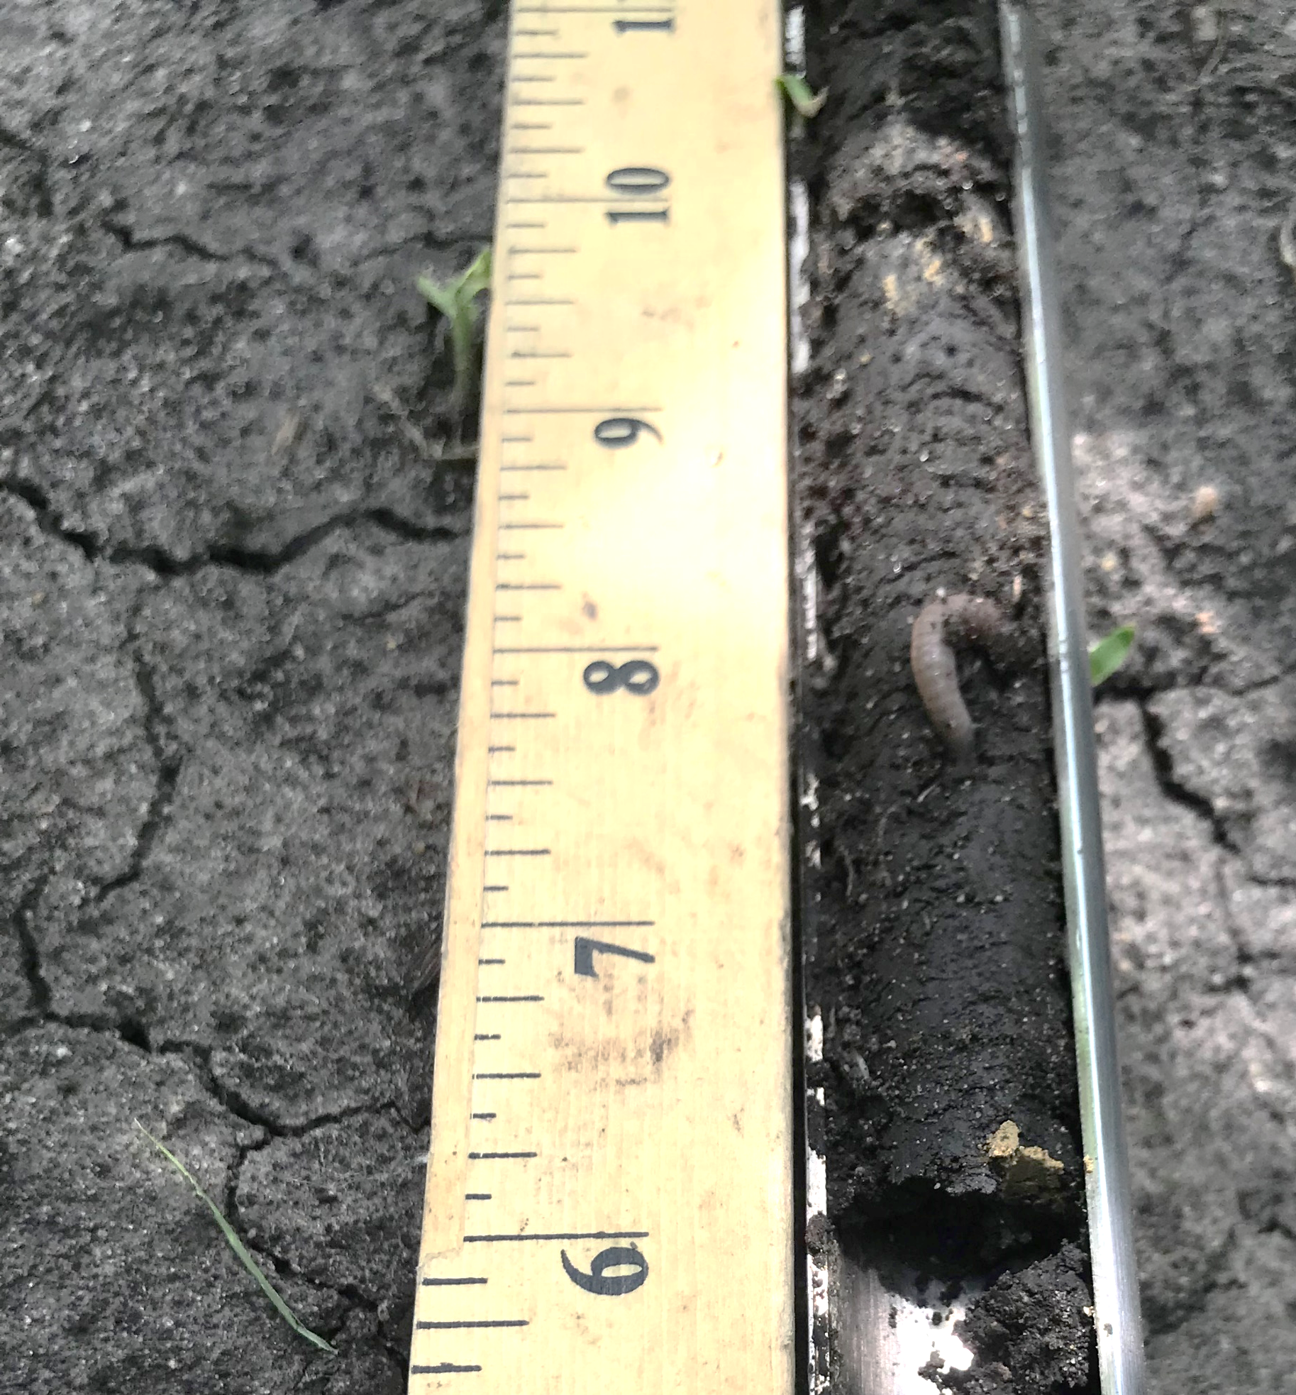
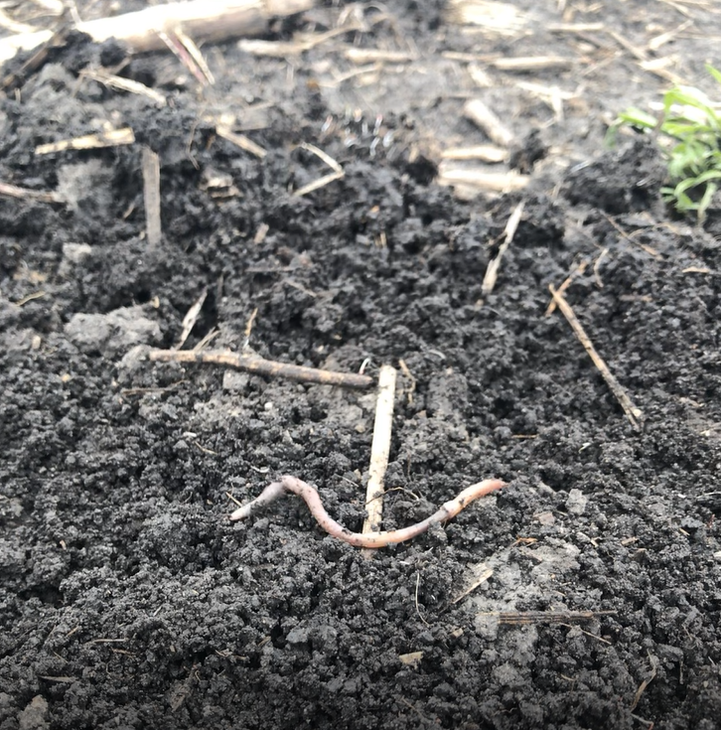
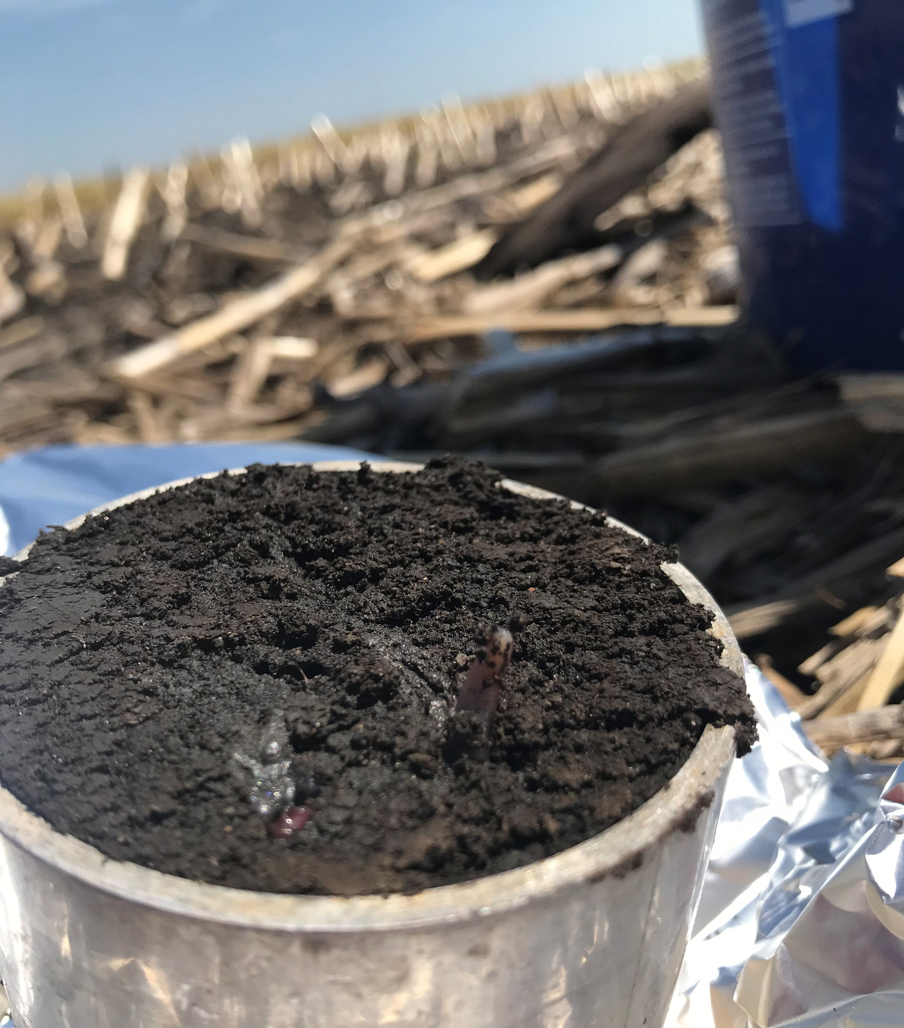
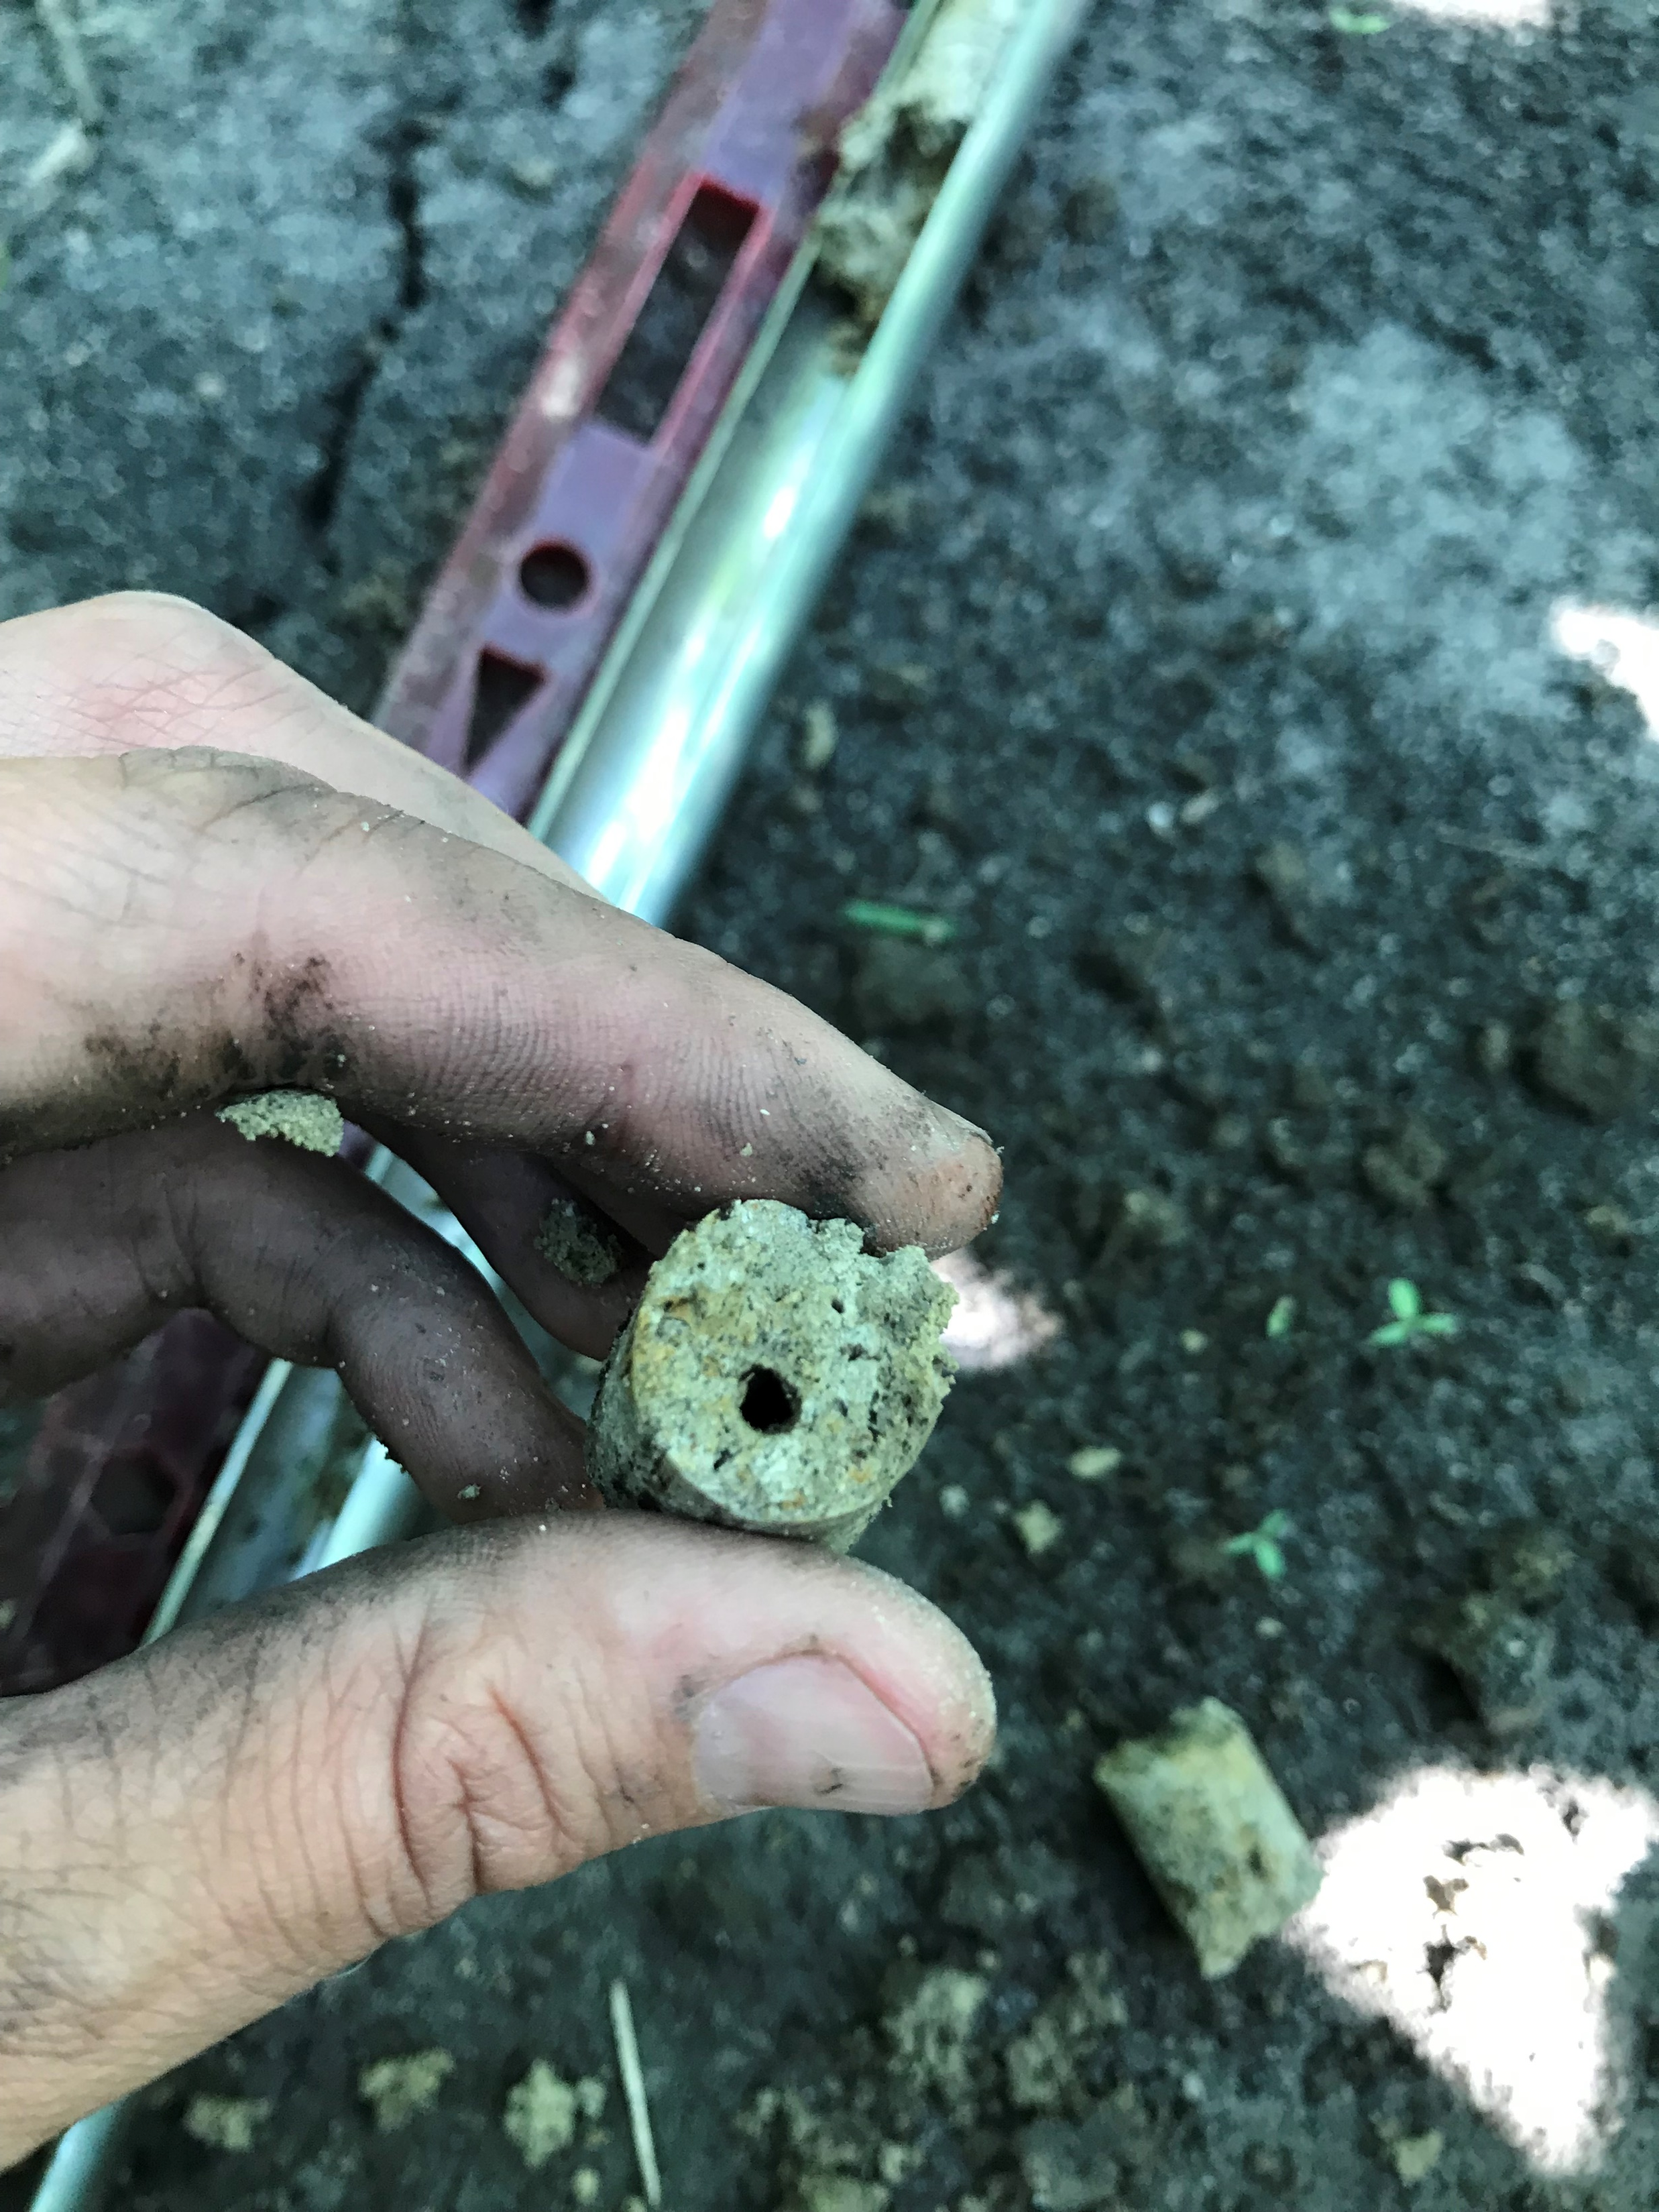

worms

Slide 23

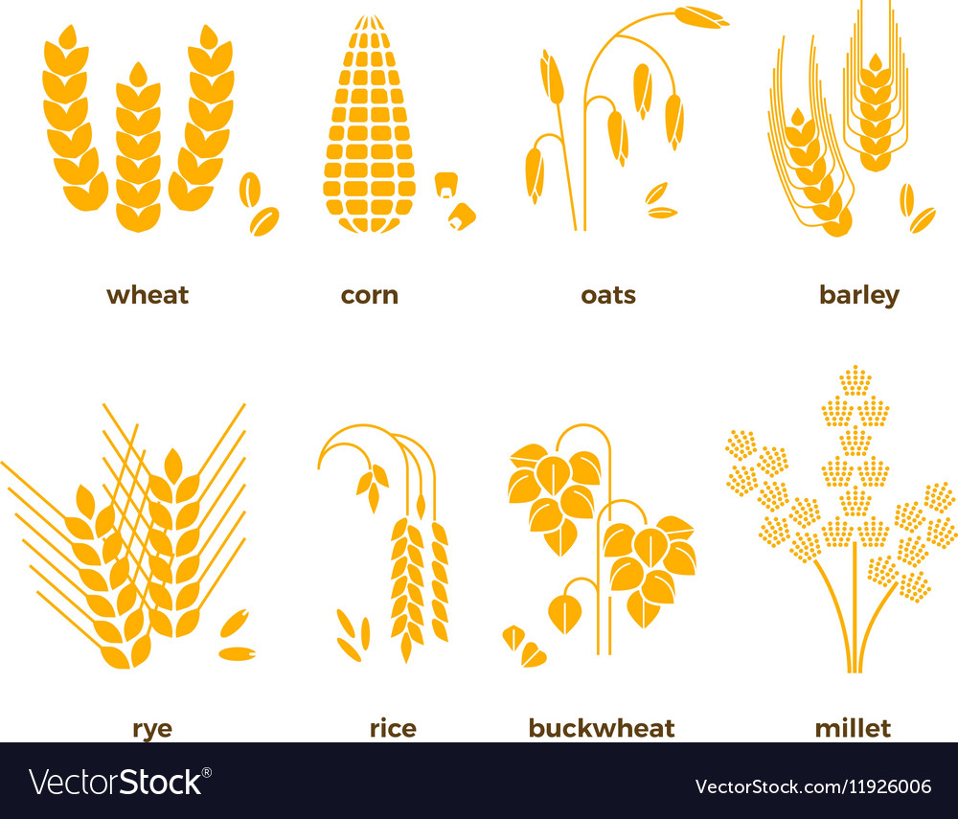

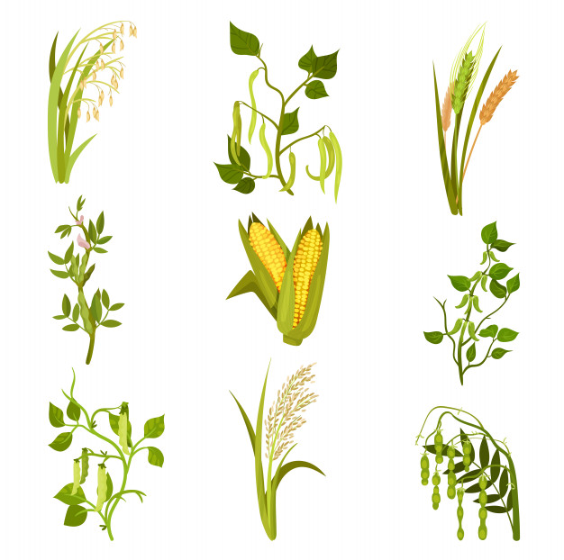


Slide 24
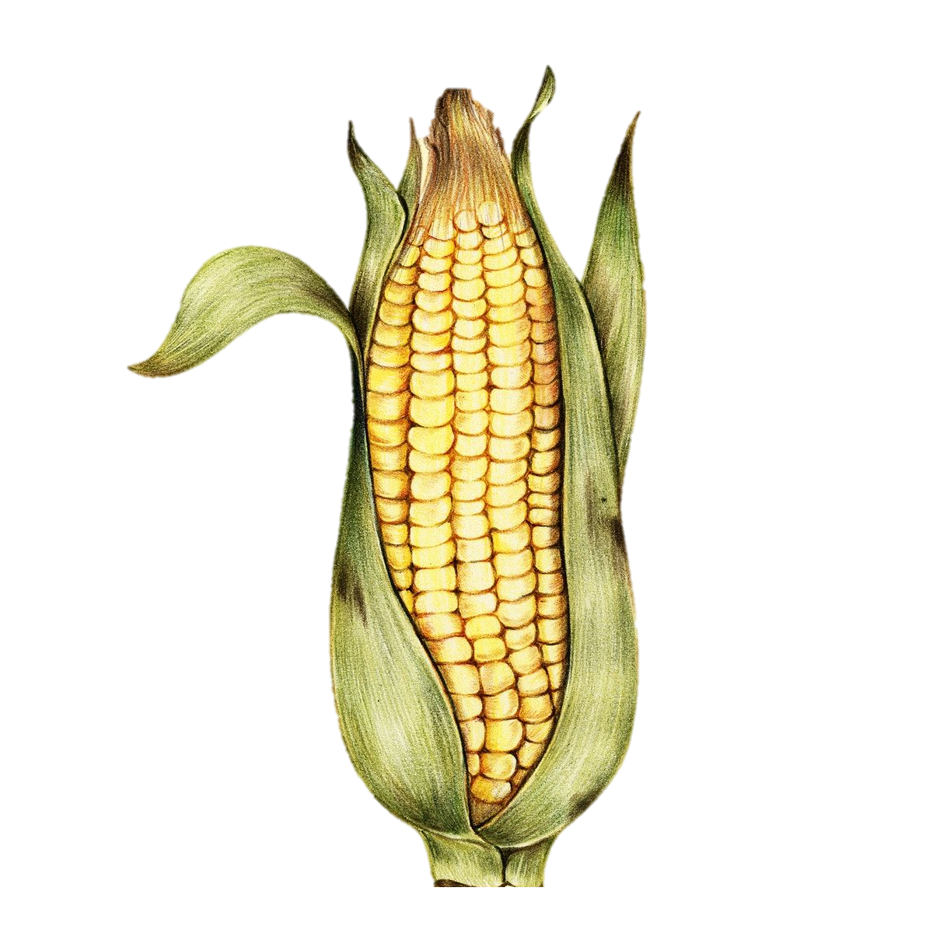

Slide 25
